Slide 1
Overview of Data Warehousing

Slide 2
Introduction to Data Warehouse
To understand data warehousing imagine a scenario.
A bank has its branches located at different regions like California, Dallas, Florida, New York.
Each branch has its own operational system.
The sales manager has connectivity and performance issues while generating a sales report.
Image Title
Image Title
Image Title
What is the solution?

Slide 3

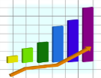
Introduction to Data Warehouse (Cont'd)
Solution:
Extract Sales information from each database and store in common repository at a single site (DW).
Now it is easy
New York
Data Warehouse
California
Florida
Sales Manager
Dallas

Slide 4
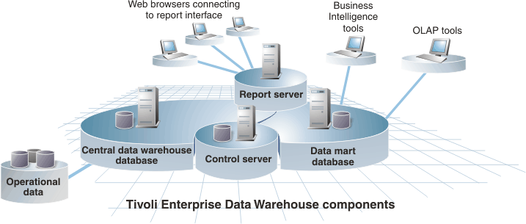
What is an Enterprise Data Warehouse?
An enterprise data warehouse is:
An unified database.
Holds all the business information of an organization.
Makes it accessible all across the company.

Slide 5
Data Warehouse - Definition
According to Bill Inmon, the “Father of Data Warehousing”, a data warehouse is:
“A collection of subject-oriented, integrated, time-variant, non-volatile data used in strategic decision making process”.

Slide 6
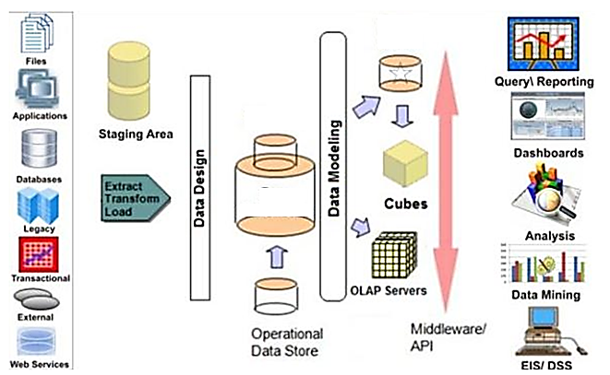
Components of a Data Warehouse
The major components of a data warehousing process are:
Data sources
Data warehouse
Meta data
Data marts
BI tools
Data Sources
BI tools
Datamart
Metadata
Data Warehouse

Slide 7
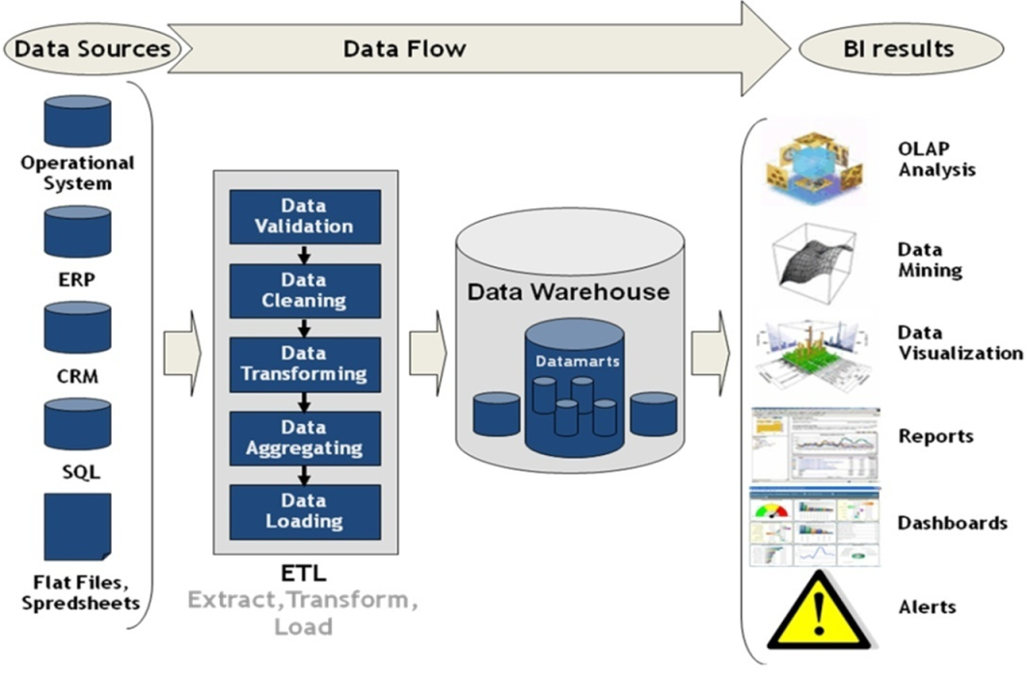
Data Warehouse - Flow of Data
Data from different sources like flat files, spreadsheets, SQL server, ODBC, Web access, etc. is extracted.
The extracted data goes through the Extract, Transform and Load (ETL) process.
Then, the processed data flows through:
Data warehouse
Data marts

Slide 8
Benefits of a Data Warehouse
Delivers enhanced business intelligence.
Saves time.
Enhances data quality and consistency.
Provides historical intelligence.
Generates a high return of investment.
Integrates data from multiple sources.
Standardizes data across the organization.

Slide 9
Application of a Data Warehouse
Data warehouses are widely used in the following fields:
Financial services
Banking services
Consumer goods
Retail sectors
Controlled manufacturing

Slide 10
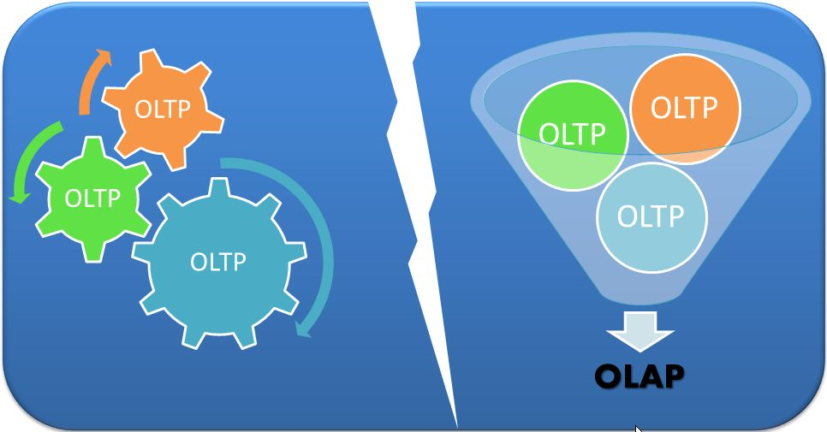
OLTP Vs. OLAP Systems

Slide 11
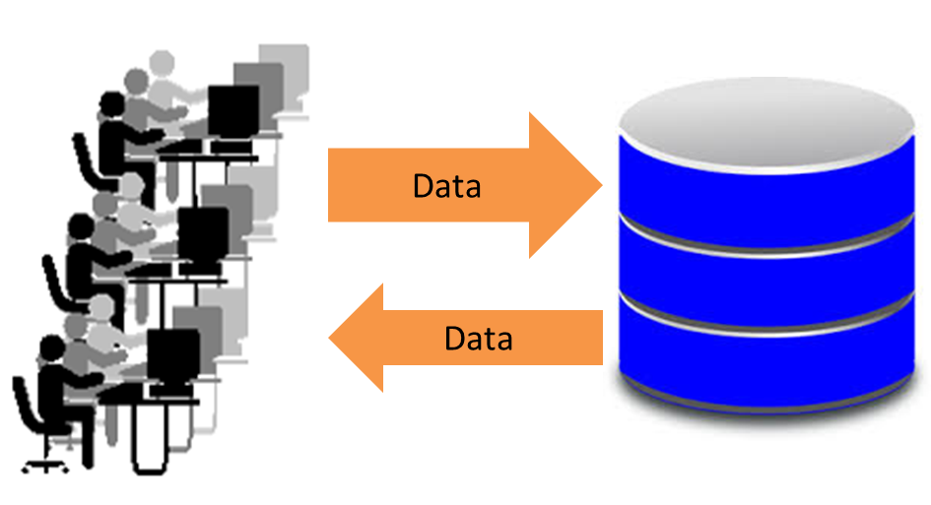
Online Transaction Processing (OLTP)
OLTP:
Is a class of software programs.
Supports transaction-oriented applications on the internet.
It deals with:
Operational data.
On-line transactions (insert, update, and delete).
Database
Notes:
OLTP (online transaction processing) is a class of software programs capable of supporting transaction-oriented applications on the Internet.
It deals with operational data, where the data is involved in the operation of a particular system and it is characterized by a large number of short on-line transactions (INSERT, UPDATE, and DELETE).

Slide 12


OLTP - Example
Cash withdrawing process through an ATM.
Notes:
The account number, ATM PIN number, amount withdrawn and balance amount in the account are operational data elements.

Slide 13
OLTP - Advantages
Fast query processing.
data integrity in multi-access environments.
High effectiveness measured by number of transactions per second.
Frequent updating and querying of data with efficient write operation.
Concurrency.
Decentralized system to avoid single points of failure.
Atomicity.
Notes:
To prevent data redundancy and to prevent update anomalies the database tables are normalized, which makes the write operation in the database tables more efficient.
OLTP systems must provide atomicity, which is the ability to fully process or completely undo an order. Partial processing is never an option.
Example: When airline passenger seats are booked, atomicity combines the two system actions of reserving and paying for the seat. Both actions must happen together or not at all.

Slide 14
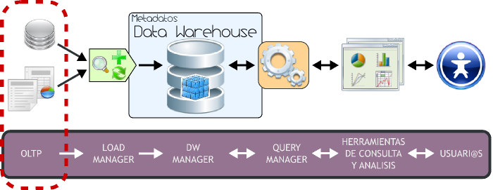
Application of OLTP
OLTP systems are used for:
Order entry.
Financial transactions.
Customer relationship management (CRM).
Retail sales.
IBM's CICS (Customer Information Control System) is a well-known OLTP product.
Notes:
Such systems have a large number of users who conduct short transactions.

Slide 15
Online Analytical Processing (OLAP)
OLAP is the technology used to perform complex analysis of the data in a data warehouse.
OLAP is a category of software technology that:
Enables analysts, managers and executives to gain insight into data.
Through fast, consistent, interactive access to a wide variety of possible views of information.
To reflect the dimensionality of the enterprise as understood by the user.

Slide 16
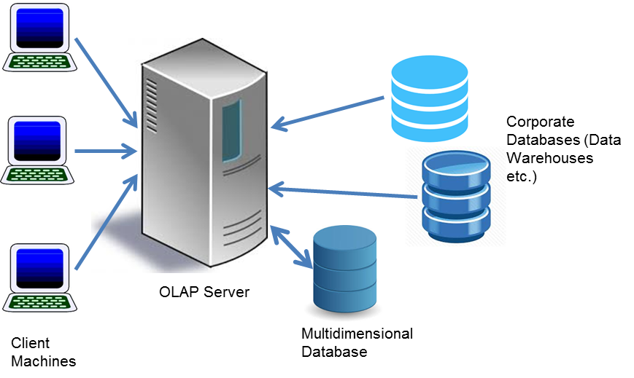
OLAP Implementation
OLAP is implemented in many different ways.
Data from different corporate databases is staged – stored temporarily into OLAP multi-dimensional databases for retrieval by the front-end systems.
OLAP is basically concerned with multidimensionality of data.
Notes:
The multidimensional database is optimized for fast retrieval.
Several techniques for the quickening of data retrieval and analysis are used on the procedural side of the database management.
Multidimensional models take advantage of inherent relationships in data to populate data in multidimensional matrices called Data Cubes or Hypercubes.
Changing from one dimension hierarchy to another is easily achieved in a data cube by a technique called pivoting (also called rotation).

Slide 17
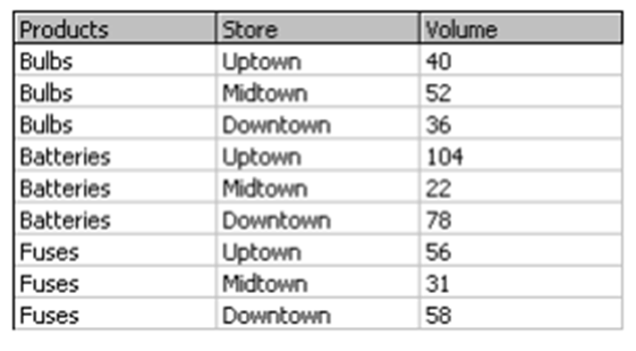
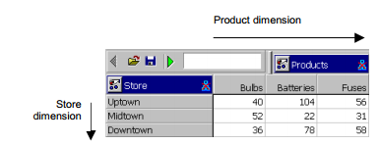
OLAP - Example
The table shows a set of sales records from three electrical stores displayed in a transactional database table.
This figure shows the same data now arranged in a "cube".
Notes:
The table shows a set of sales records from three electrical stores displayed in a transactional database table. There are two field columns "Products" and "Store" that contain textual information about each data record and a third value column "Volume".
In this cube, the horizontal dimension contains the product names and is referred to as the "Products dimension". The vertical dimension contains the store names and is referred to as the "Store dimension".
A two-dimensional layout, often referred to as "a spreadsheet view" as it resembles a typical spreadsheet.

Slide 18
Application of OLAP
OLAP is widely used in several realms of data management. Some of these applications include:
Financial applications
Activity-based costing (resource allocation).
Budgeting.
Marketing/sales applications
Market research analysis
Sales forecasting
Promotions analysis
Customer analyses
Market/customer segmentation
Business modelling
Simulating business behaviour.
Extensive, real-time decision support system for managers

Slide 19
Benefits of OLAP
OLAP holds several benefits for businesses:
Increased productivity through multidimensional data views
Inherent flexibility to the organized databases
Simulation of business models and problems
Reduced application backlog and query drag
Faster information retrieval
Notes:
OLAP helps managers in decision-making through the multidimensional data views, thus increasing their productivity
OLAP applications are self-sufficient owing to the inherent flexibility provided to the organized databases.
It enables simulation of business models and problems, through extensive usage of analysis-capabilities.
In conjunction with data warehousing, OLAP can be used to provide reduction in the application backlog, faster information retrieval and reduction in query drag

Slide 20
Extract Transform Load

Slide 21
ETL – An Introduction
Over a period, a company went through various changes in both internal operations and external customer interactions.
The company acquired several specialized tools and systems from different technological background and vendors.
The company ended up having various disconnected systems with silos of data.

Slide 22
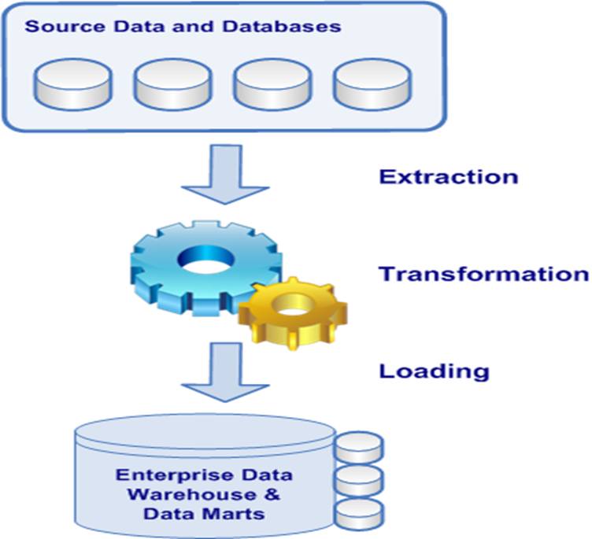
ETL – An Introduction (Cont’d)
There are two ways to address this challenge:
Pull data from all these systems manually, then analyze via manual means.
Pull data from all these systems via automated means, convert data in a format that supports analysis, and save it.
Notes:
To solve this problem, companies use the Extract, Transform and Load (ETL) process to extract this data, transform it into an appropriate structure and load it into the database.

Slide 23
ETL – Definition
ETL is short for extract, transform, load.
ETL= Extract + Transform + Load
Basically ETL is used to:
Migrate data from one database to another.
Form data marts and data warehouses.
Convert databases from one format or type to another.
Three database functions are combined into one tool to pull data out of one database and place it into another database.

Slide 24
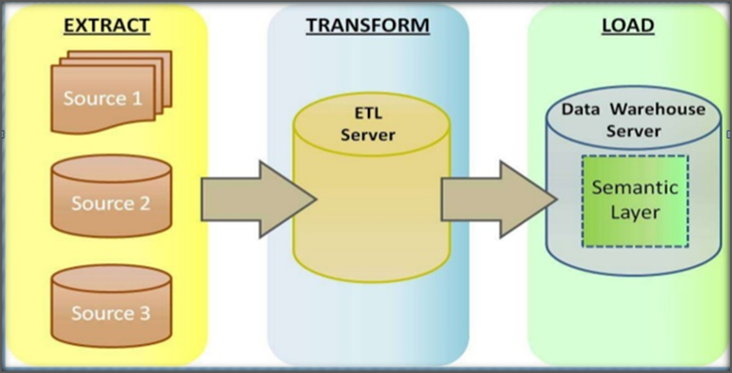
ETL – Process
Extract
Extract relevant data from different sources and different format.
Transform
Transform data to data warehouse (DW) format within ETL server.
Build keys, etc.
Cleansing of data.
Load
DW server loads data into DW.
Build aggregates, etc.

Slide 25
Data Extraction
Extraction is the operation of extracting data from a source system and moves it to the staging database.
Data Sources
BI tools
Datamart
Metadata
Data Warehouse

Slide 26
Data Extraction (Cont’d)
Data is extracted from heterogeneous data sources. Each data source has its distinct set of characteristics.
Some external data sources include:
Operational databases (relational, hierarchical, network, itp.).
Files of standard applications (Excel, COBOL applications).
Additional databases (direct marketing databases) and data services (stock data).
And other documents (.Doc, XML, WWW).

Slide 27
Data Extraction (Cont’d)
Effective data extraction is a key to the success of data warehouse.
List of data extraction issues:
Source identification | Identify source applications and source structures.
Method of extraction | For each data source, define whether the extraction process is manual or tool-based.
Extraction frequency | For each data source, establish how frequently the data extraction must by done — daily, weekly, quarterly, and so on.
Time window | For each data source, denote the time window for the extraction process.
Job sequencing | Determine whether the beginning of one job in an extraction job stream has to wait until the previous job has finished successfully.
Exception handling | Determine how to handle input records that cannot be extracted.

Slide 28
Extraction Methods
Logical extraction methods
Full extraction: Data is extracted completely from the source system. E.g. Export file of a distinct table or a remote SQL statement scanning the complete source table.
Incremental extraction or change data capture: Copies the specified data that has changed since the last time the ETL process was run.

Slide 29
Extraction Methods (Cont'd)
Physical Extraction Methods
Online Extraction
Connect directly to the source system to access the source tables.
E.g. snapshot logs or change tables.
Offline Extraction
The data is not extracted directly from the source system but is staged explicitly outside the original source system.
E.g. Flat files, redo and archive logs, dump files, transportable tablespaces.

Slide 30
Data Transformation
Remove all inconsistencies and redundancies of data coming to the data warehouse from operational data sources.
It includes the following steps:
Validation of input data before being loaded in the tables.
Transformation of input data into the format of the target database.
Any additional processing.

Slide 31
Data Transformation – Basic Tasks
The set of basic tasks are:
Selection | Selection of either whole records or parts of several records from the source systems.
Splitting/joining | Data manipulation on the selected parts of source records.
Conversion | Standardization of data.
Summarization | Summarization of data as needed by user for analysis or querying.
Enrichment | Rearrangement and simplification of individual fields.

Slide 32
Data Transformation – Data Cleansing
Data cleansing is detecting and removing errors and inconsistencies from data in order to improve the quality of data.
Common aspects of data cleaning transformations include:
Find and replace | For instance, to synchronise a building name where there were instances of the same building referred to under different abbreviations – i.e. 'London health centre', 'london HC', 'london hth cen' etc.
Convert case | For example, on the 'title' column of a 'customers' table, converting all instances of 'MRS', 'mrs' and 'mrs' to 'mrs‘.
NULL value handling | Conversion to a default value.
Data type conversion | To syncronise data from different systems, i.e. The customerid may be an integer in one system but a character data type in another system.
Standardization of elements | Examples: – 0/1, m/f, m/w, M/F, ... m/f – „The woods dr “ „the woods drive“

Slide 33
Data Transformation – Data Cleansing (Cont’d)
Decomposing of data items into parts | Example: – [name: „Joe Cool“¨] [firstname: „Joe“, lastname: „Cool“] – [date: „12.12.2002“] [day: 12, month: 12, year: 2002]
Duplicate elimination | Determine whether differing records represent the same real-world entity – Example: „Joe Cool“, „J. Cool“, „Snoopy“ „Joe“ „Cool“
Correctness of data | Example (street name does not exist and is replaced with the "closest" one): – „The Wolves Dr ive “ -> „The Woods Drive“
Splitting of source files into multiple staging files that can be used to drive multiple target table loads.
Merging data from different data sources.

Slide 34
Case Study
Scenario:
The publishing house of a company was facing issues during execution of marketing campaigns. Some marketing packages sent via mail were undelivered and returned; some packages were delivered more than once to a single address and so on.
What is the solution?

Slide 35
Case Study
Problem:
Inconsistent and poor quality of customers' data.
Solution:
The company tried a data cleansing tool which helped to:
Check all mailing addresses.
Rectify incorrect ones.
Verify other customer data as emails or phones.
Find duplicate entries in customer database.
Enrich customers' information from external databases.

Slide 36
Data Transformation – Data Quality Verification
Data quality is critical because it:
Boosts confidence.
Enables better customer service.
Enhances strategic decision making.
Reduces risks from disastrous decisions.

Slide 37
Data Transformation – Data Quality Verification (Cont'd)
This stage compares the data extracted in the previous step with the data quality rules specified in the business specification of the data warehouse.
Following are some of the data quality dimensions measured:
Accuracy
Domain integrity
Data Type
Consistency
Redundancy
Completeness
Duplication
Conformance to Business rules
Structural definiteness
Data Anomaly
Clarity
Timely
Usefulness
Adherence to data integrity rule
Notes:
Data quality rules can be the responsibility of the owner of the source system or the responsibility of the DW administrator.

Slide 38
Data Transformation – Data Quality Verification (Cont’d)
If data does not meet the data quality rules, then data is:
Rejected.
Kept in a holding area.
Added to the data warehouse with its errors.
This verification is very important because it prevents invalid data from entering into data warehouse and eventually stops it from participating in business performance metrics.
Notes:
During the transformation phase, the extracted data is submitted to several validations.
Checks and conversions are performed, like data format, data width, case and data type conversions, data lookups, data splitting and joining, null value handling etc.
If data does not meet the data quality rules then there are a number of options:
Reject the data so it doesn't enter the DW
Keep the data in a holding area so that it can be fixed before insertion into data warehouse
Added to the data warehouse with its errors – this can lead to major problems down the line
When data is rejected or placed in a holding area the administrator of the source system must be informed and be given details of/access to the rejected data so that they can try and fix the issues that are causing the problems.

Slide 39
Data Transformation – Data Quality Verification (Cont'd)
Data Quality Testing
Syntax Tests: Report dirty data based on invalid characters, character pattern, incorrect upper or lower case order etc.
Reference Tests: Check the data according to the data model e.g. Customer ID.

Slide 40
Data Transformation – Integration and Aggregation
Data Integration: Process of consolidating multiple data sources into a uniform data interface for data analysis.
Data Aggregation: Process in which information is gathered and expressed in a summary form to enable quicker running of queries.

Slide 41
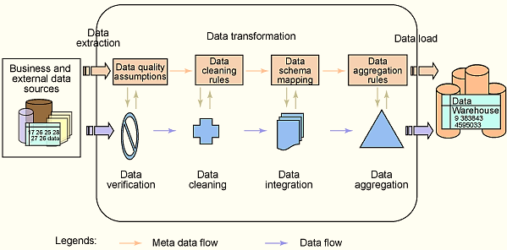
Data Transformation – Process Flow
After data has passed through quality checks and the required transformations, it is ready for loading into the data warehouse.

Slide 42
Data Load
This is the stage that 'uploads' the transformed data to the live data warehouse.
Loading can be carried out in two ways:
Refresh:
Data warehouse data is completely rewritten i.e. Older data is replaced.
Used in combination with static extraction to initially populate a data warehouse.
Update
Only those changes applied to source data are added to the data warehouse.
Carried out without deleting or modifying pre-existing data.
Used in combination with incremental extraction to update data warehouses regularly.

Slide 43
Data Load (Cont'd)
Speed of loading can be influenced by:
Size of tables.
Proportion of updates/inserts.
Bulk load utilities and SQL insert/update/delete (IUD) are used for loading.
Commercial off-the-shelf ETL tools support:
In sequential and parallel modes.
All major databases as target databases (data warehouse) and leverage database specific performance features.

Slide 44
Data Load (Cont'd)
Points to be remembered during data loading:
Data warehouse has to be offline.
Loads may be scheduled.
Do test loads to verify the correctness and to estimate the running times.
Do not expect every record in the source load image file to be successfully applied to the data warehouse.
Plan for quality assurance of the loaded records.
Consider best and suitable options like web, FTP, and database links to transport the load images to the data warehouse server.
Consider the necessary bandwidth needed and also the impact of the transmissions on the network.

Slide 45
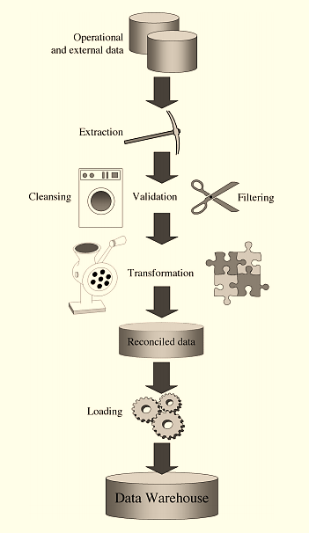
ETL - Summary

Slide 46
ETL - Uses
ETL is used for:
Data extraction from heterogeneous data sources.
Data transformation, integration, and cleansing.
Data quality analysis and control.
Data loading.
High-speed data transfer.
Data refreshment.
Managing and analyzing metadata.

Slide 47

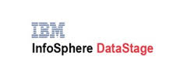

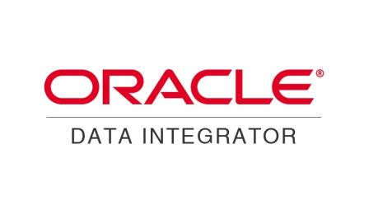

ETL - Tools
MS SQL Server Integration Services(SSIS)
IBM Infosphere DataStage
SAS ETL Studio
Oracle Warehouse Builder
Oracle Data Integrator
Business Objects Data Integrator
Pentaho Data Integration

Slide 48


